Slide 1

Heart disease prediction
Project group 9:
Duc Anh Khue Bui
Lipsa Sharma
Manish Thapa
Jingwen Zhou

Slide 2




Introduction
What is heart disease:
How heart disease impact on our lives:
The prediction of heart disease risk:
Heart disease prediction as a data analyst:
Supervised machine learning model

Slide 3
Dataset
What are information attribution:
The objective from the data is to determine
Age:
Sex
ChestPainType
RestingBP
Cholesterol
FastingBS
RestingECG
MaxHR
ExerciseAngina
Oldpeak
ST_Slope
Heartdisease output
The age group with potential risk
The gender is highly susceptible
Heart disease over chest pain type
The correlation between the factors
The MaxHR by age

Slide 4
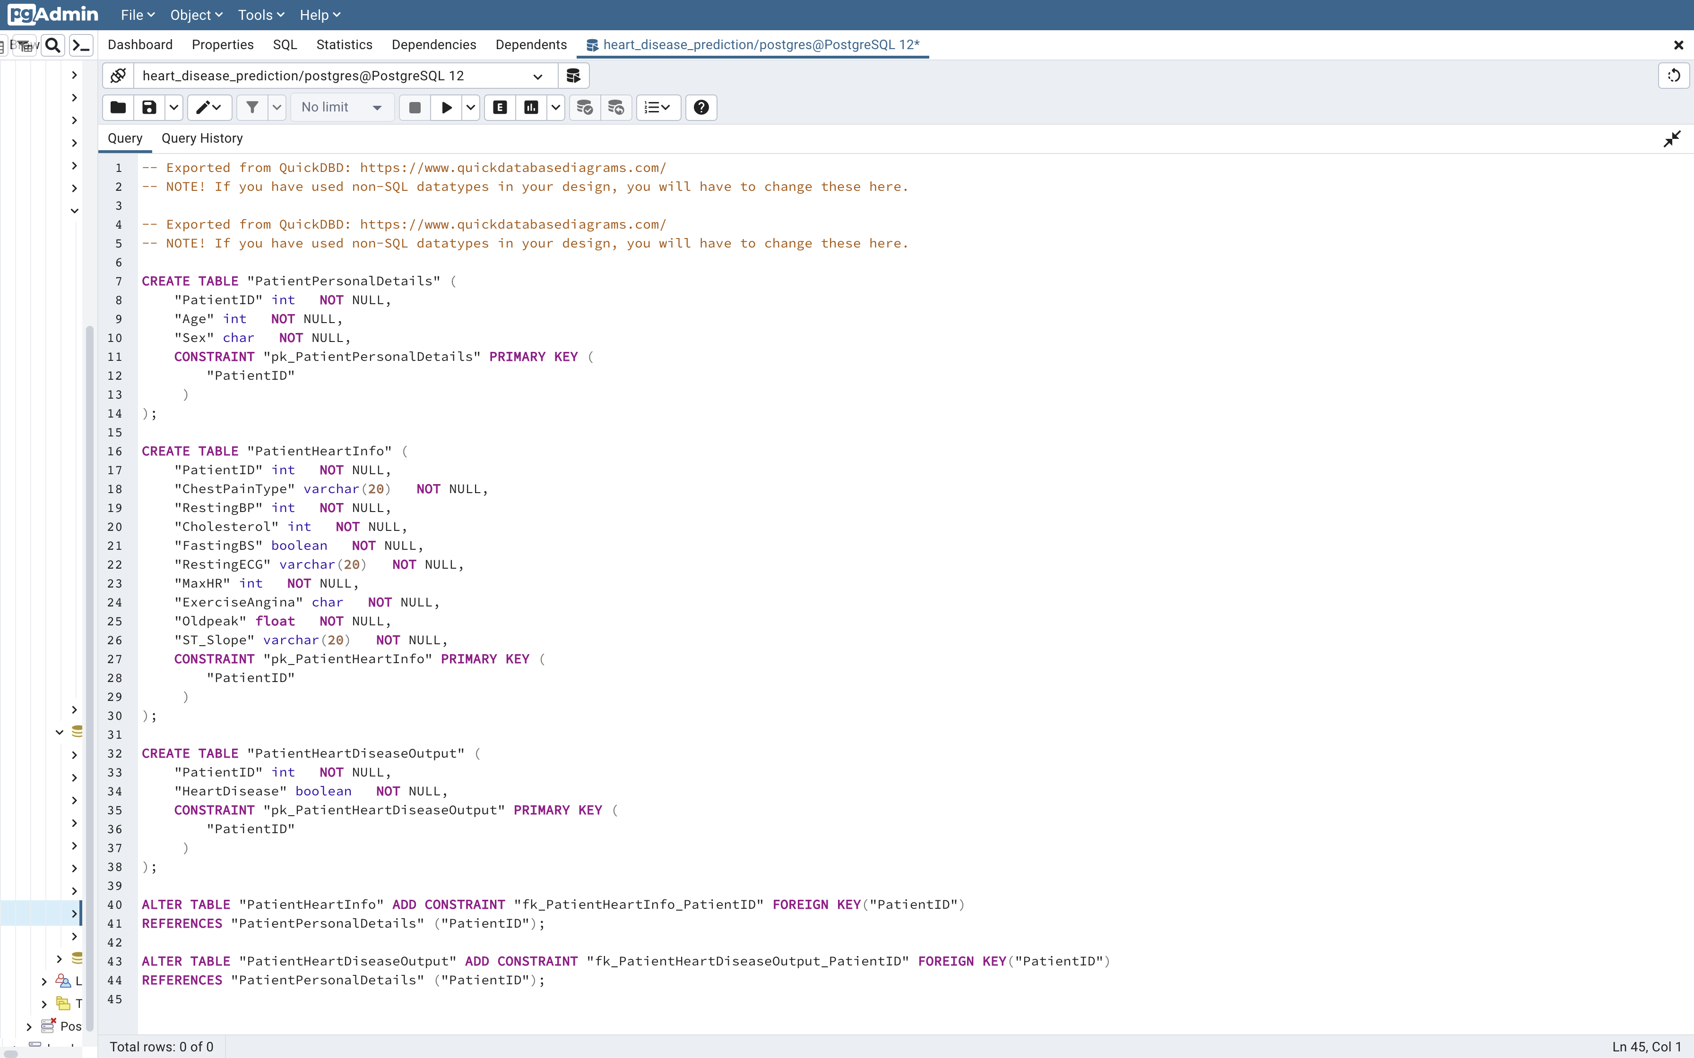
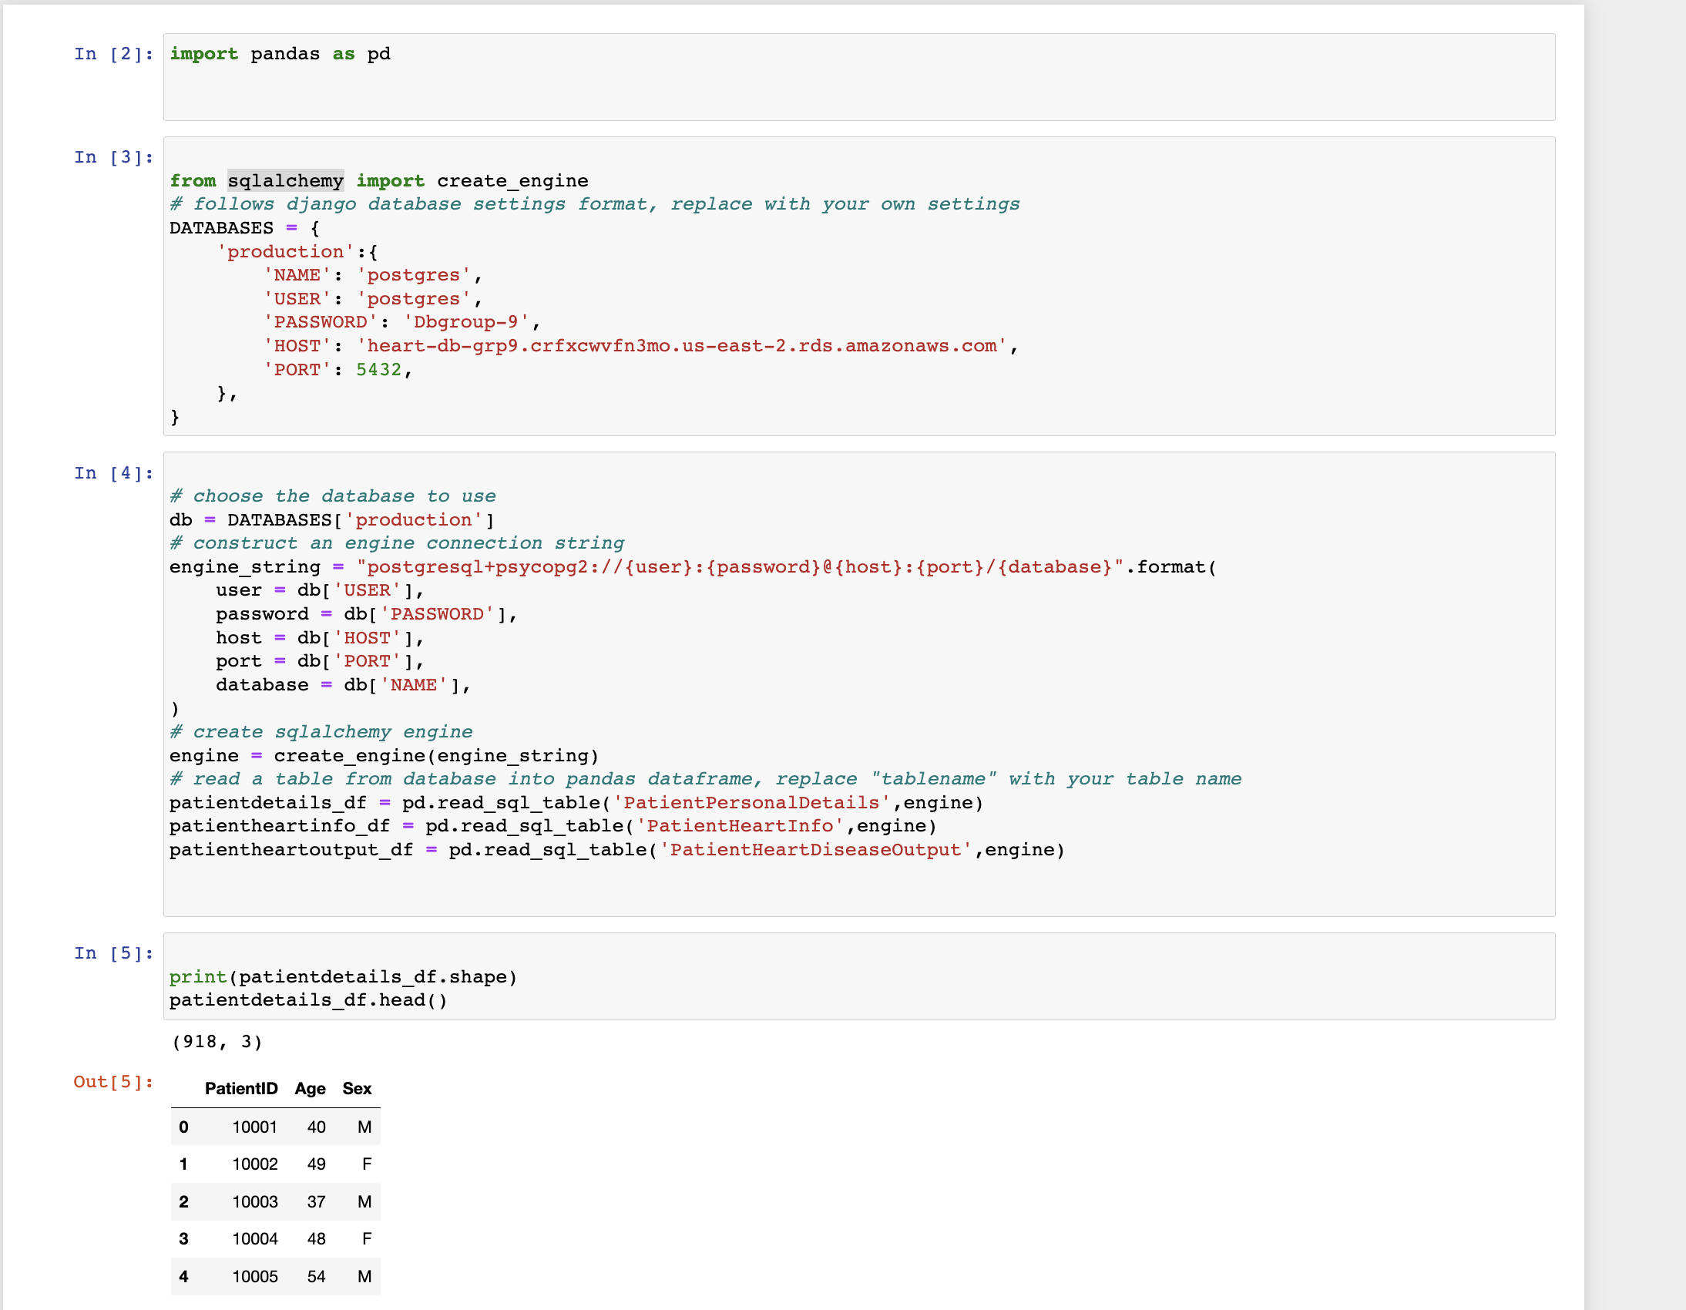
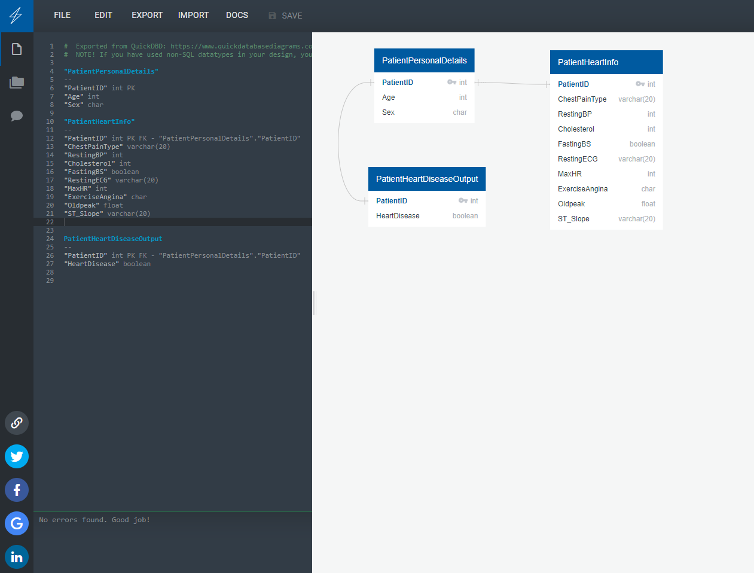
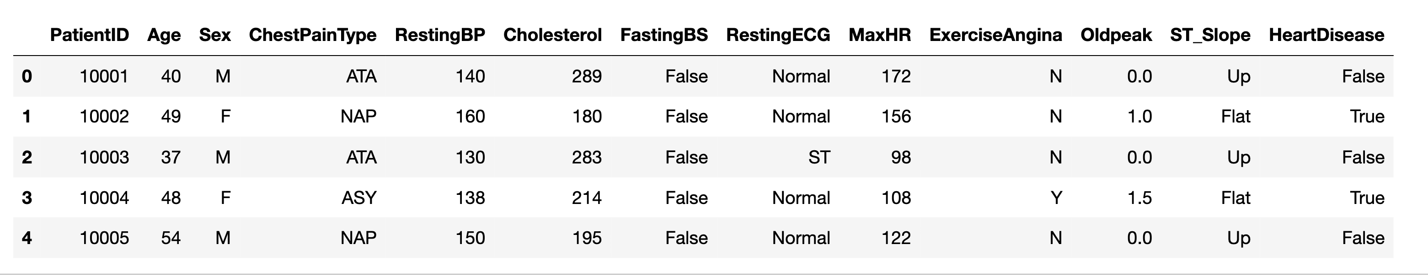
Creating tables
Entity Relationship Diagram:
Extract, transform and load the data
Adding new column PatientID as a primary key
Quick Data Base Diagram for foreign key and primary key
Writing SQL queries on prosgresql to create 3 tables
Put the data to AWS amazon
Use sqlalchemy for ETL

Slide 5
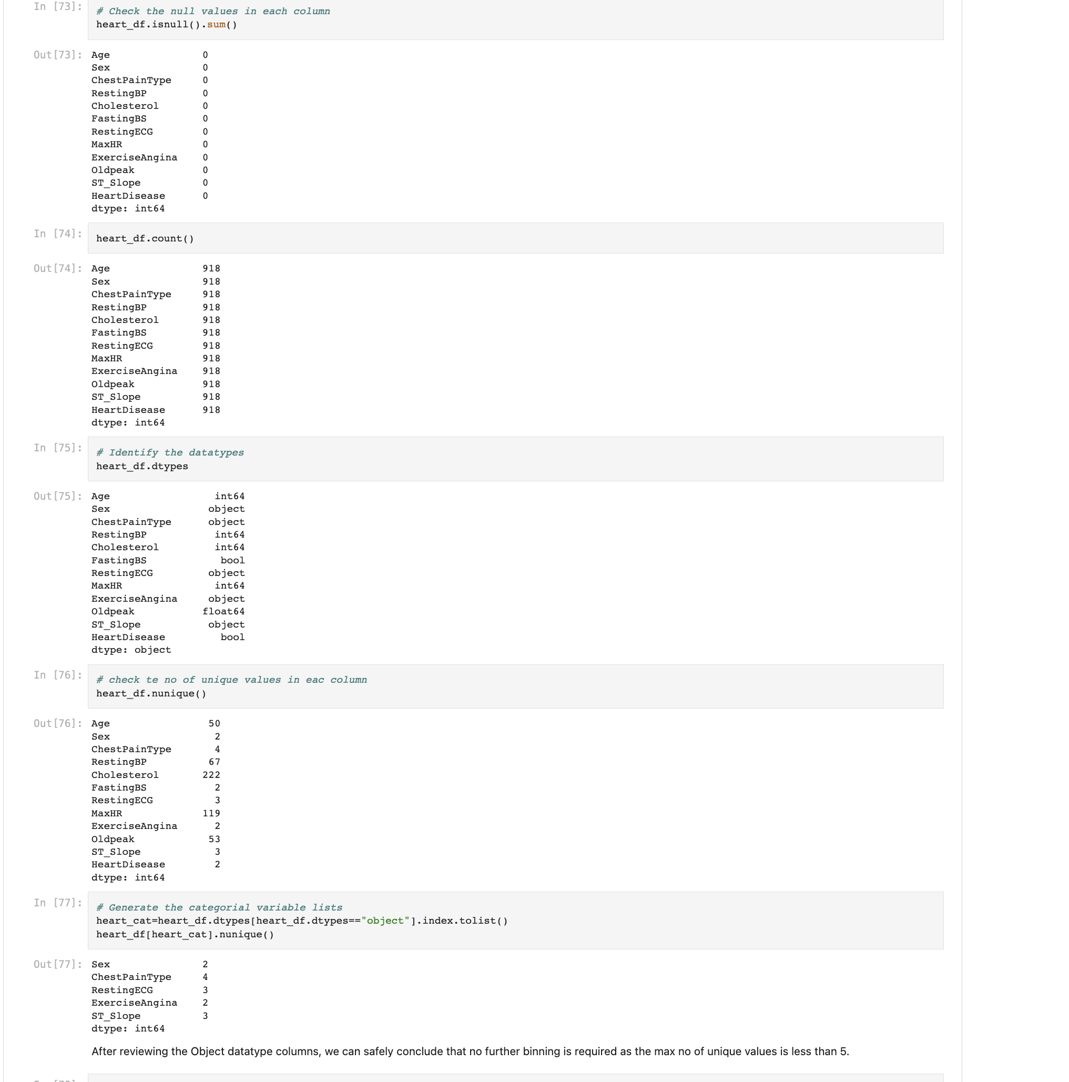
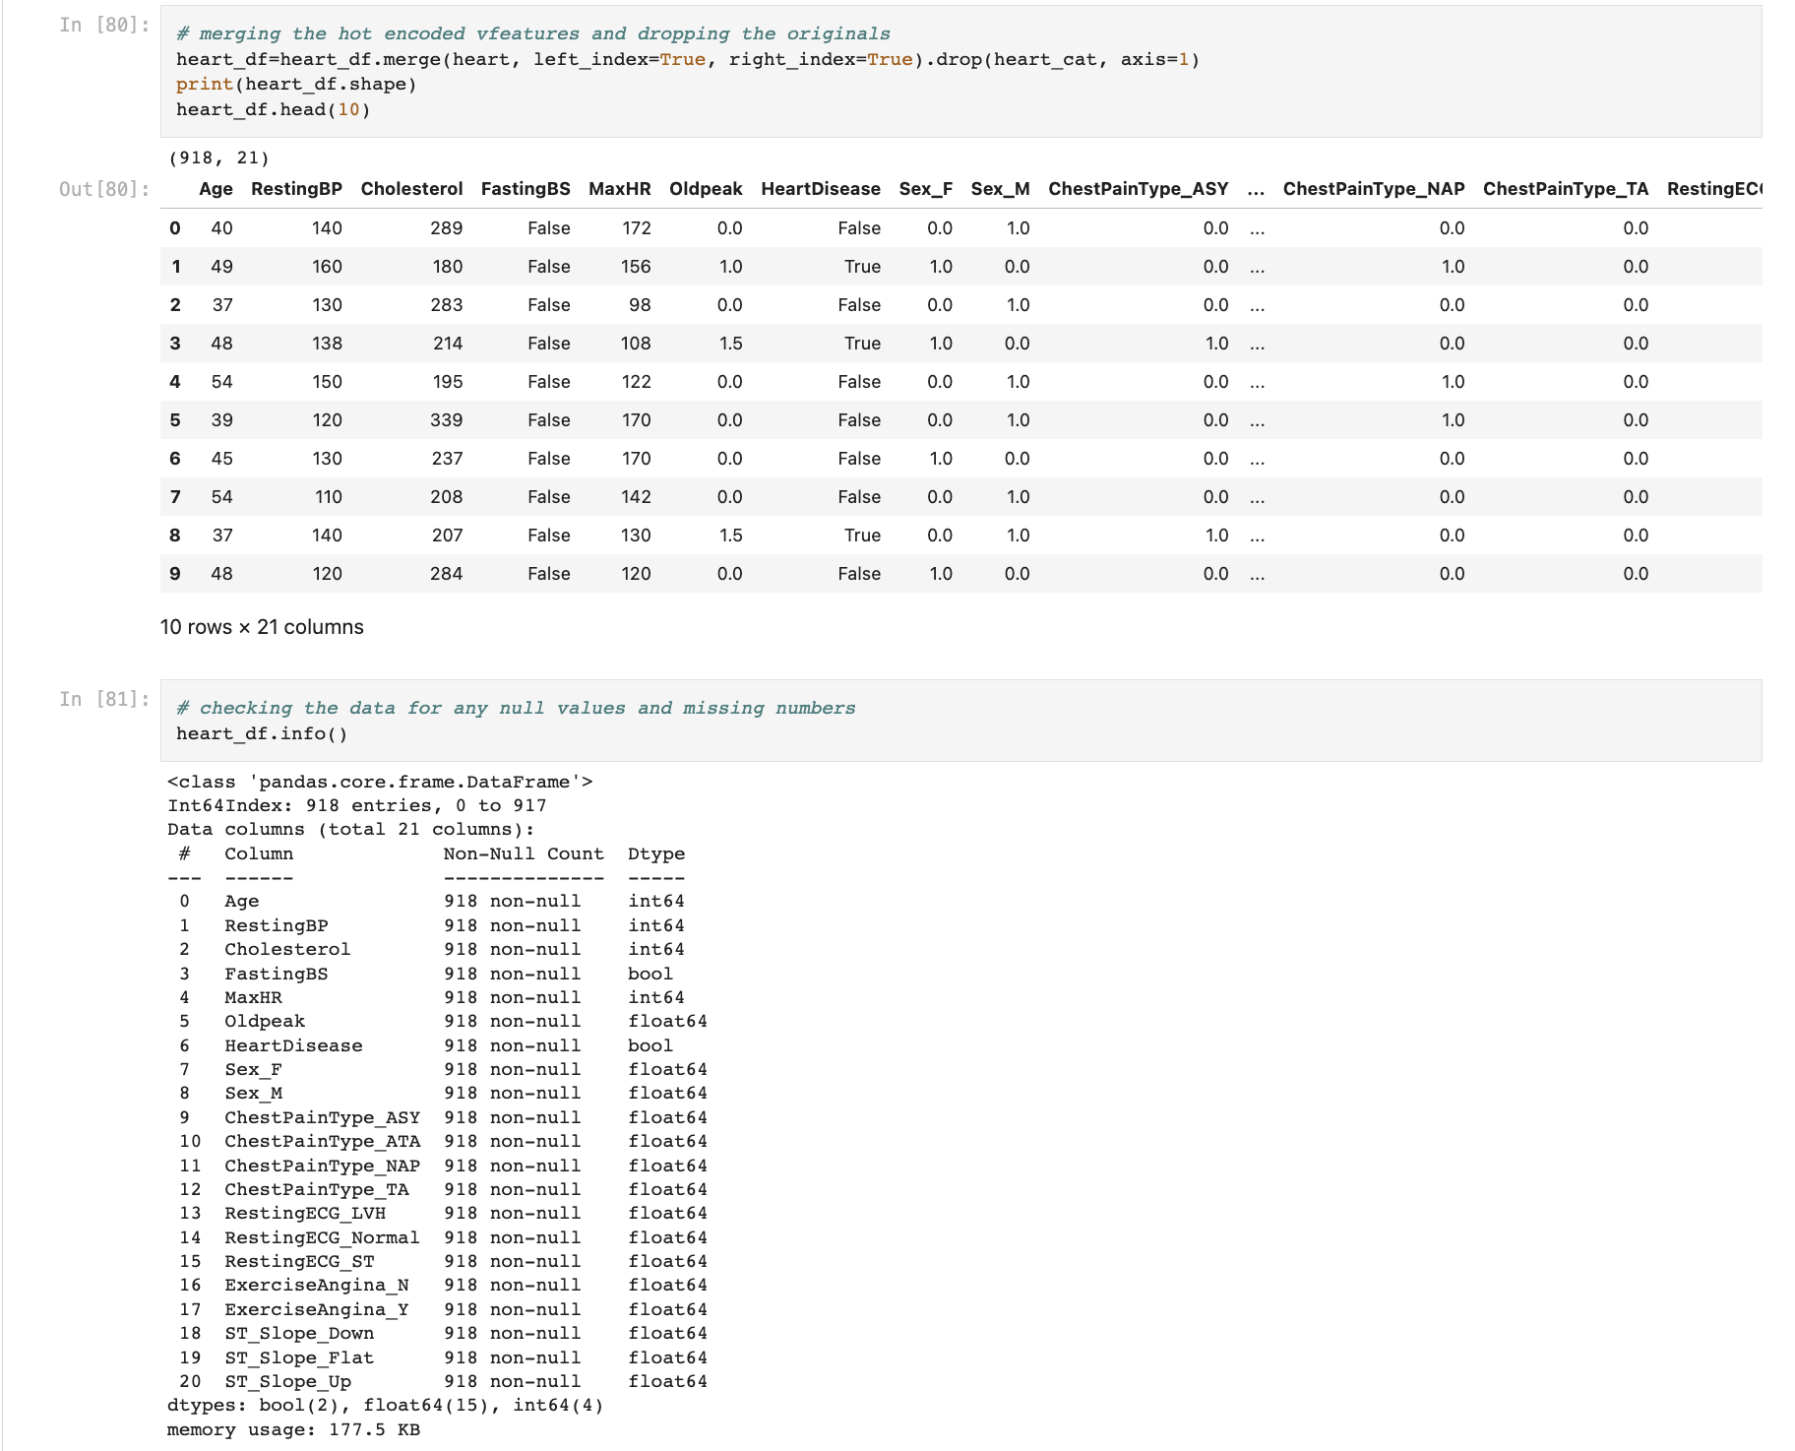
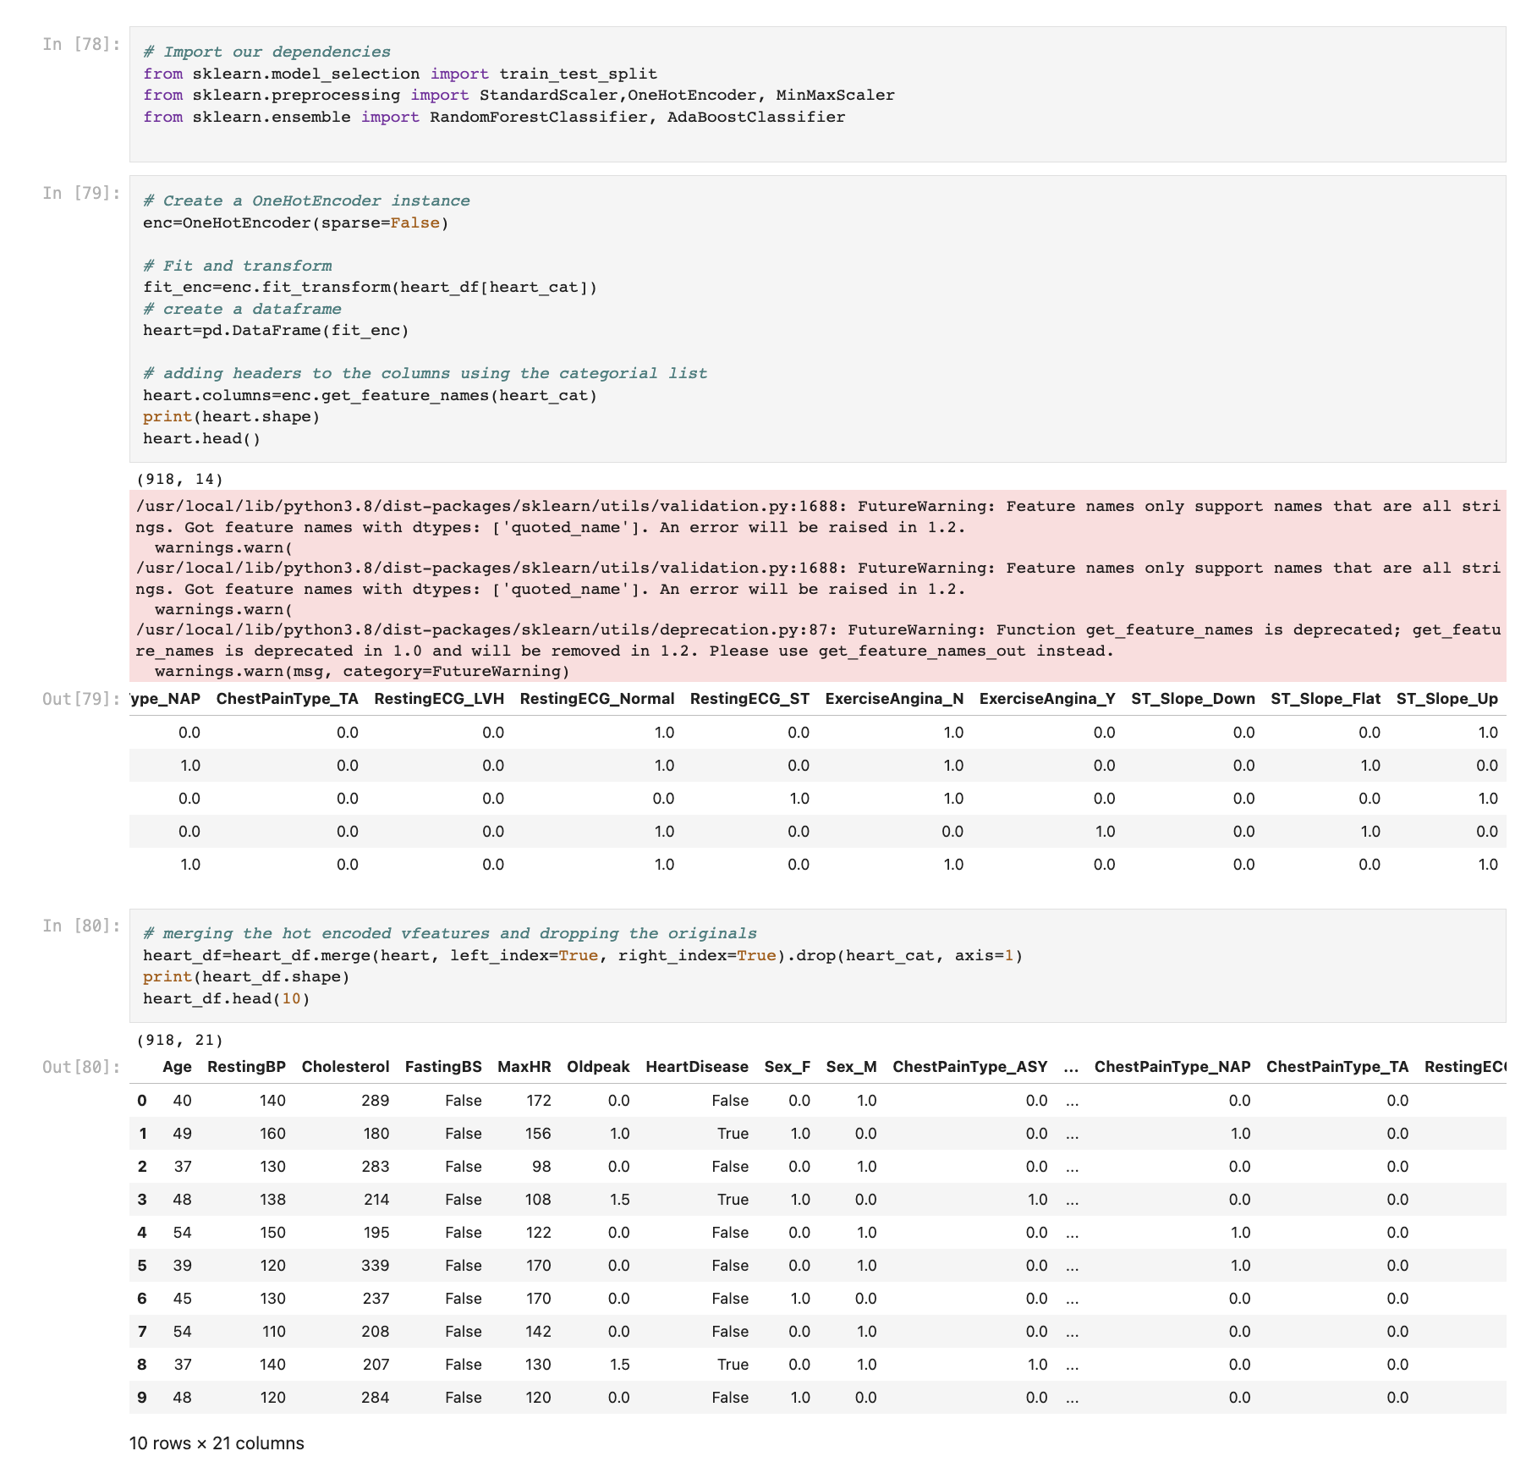
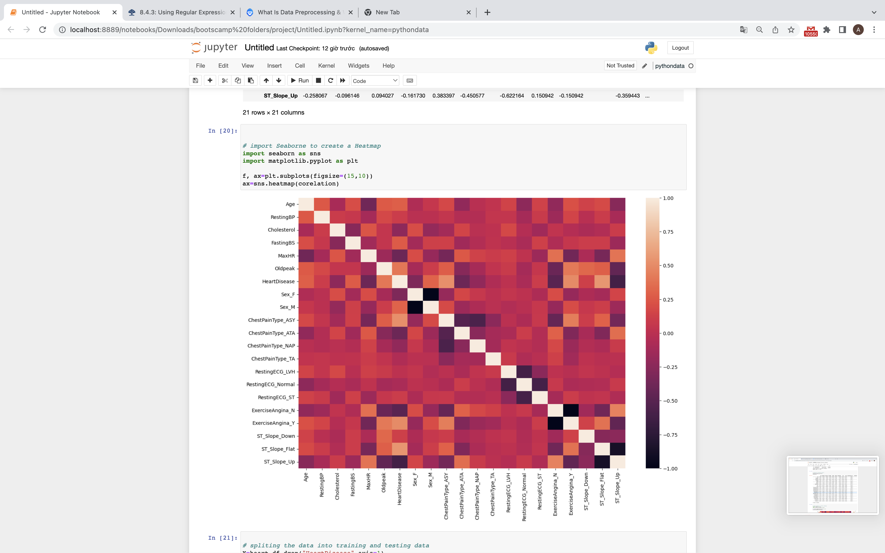
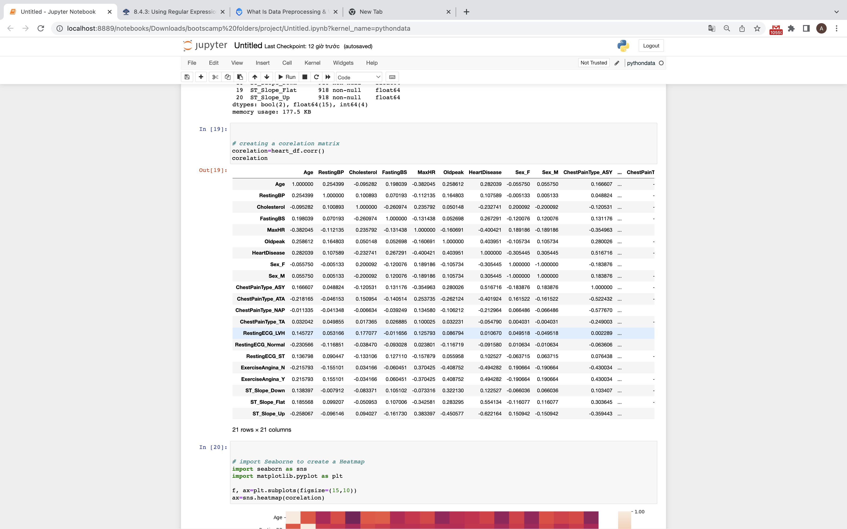
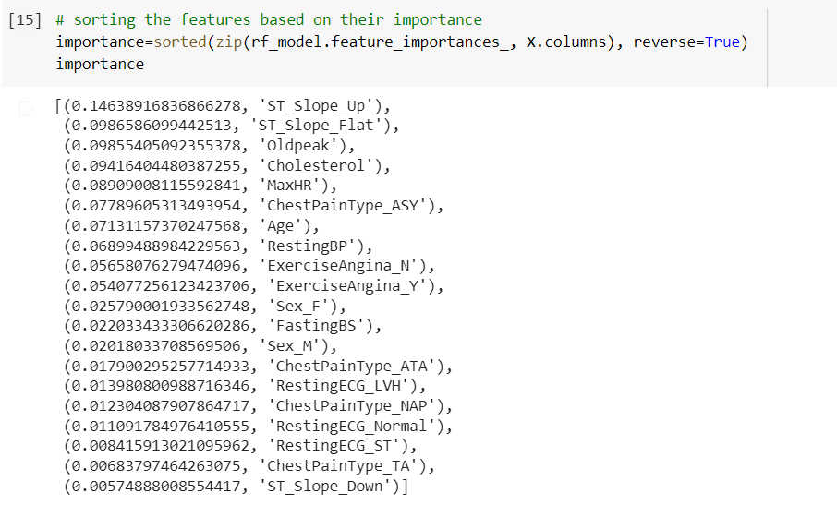
Data exploration
Data preprocessing
File was checked for any null values/empty columns
Object columns were identified and checked
Correlation between the variables and heat map
Importance feature

Slide 6
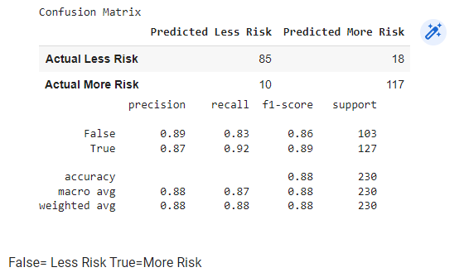
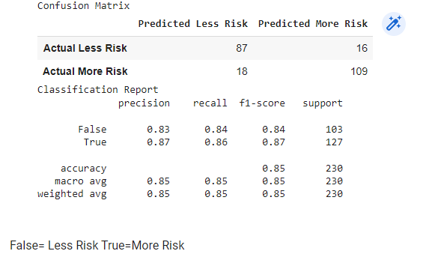
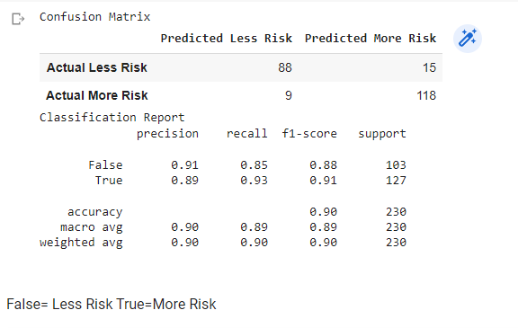
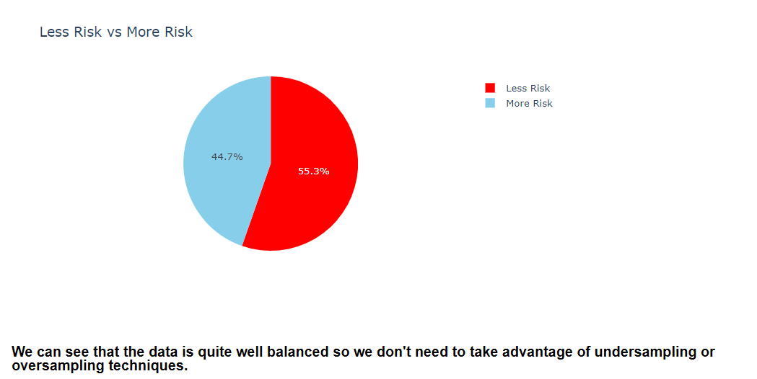
Data evaluation and testing
Random Forest Classifier model
AdaBoostClassifier model
Logistic Regression model
Imbalance check

Slide 7
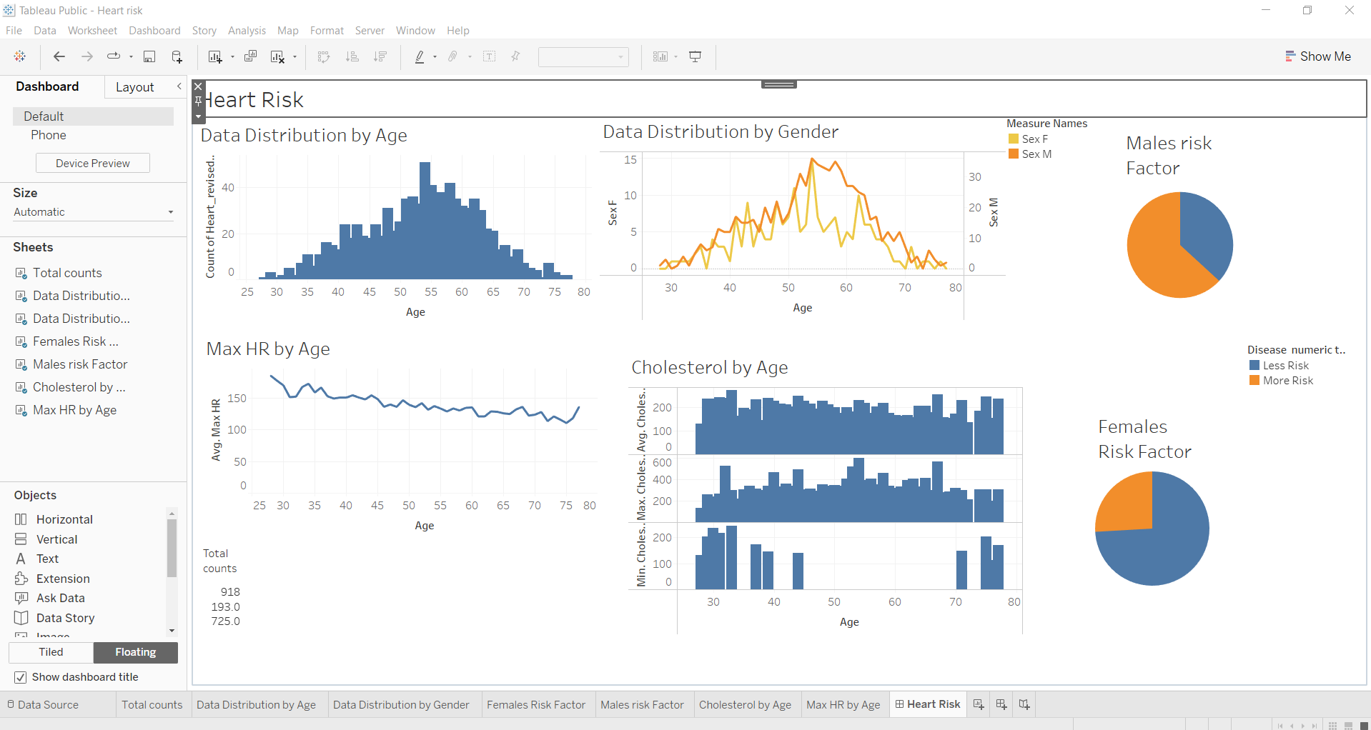
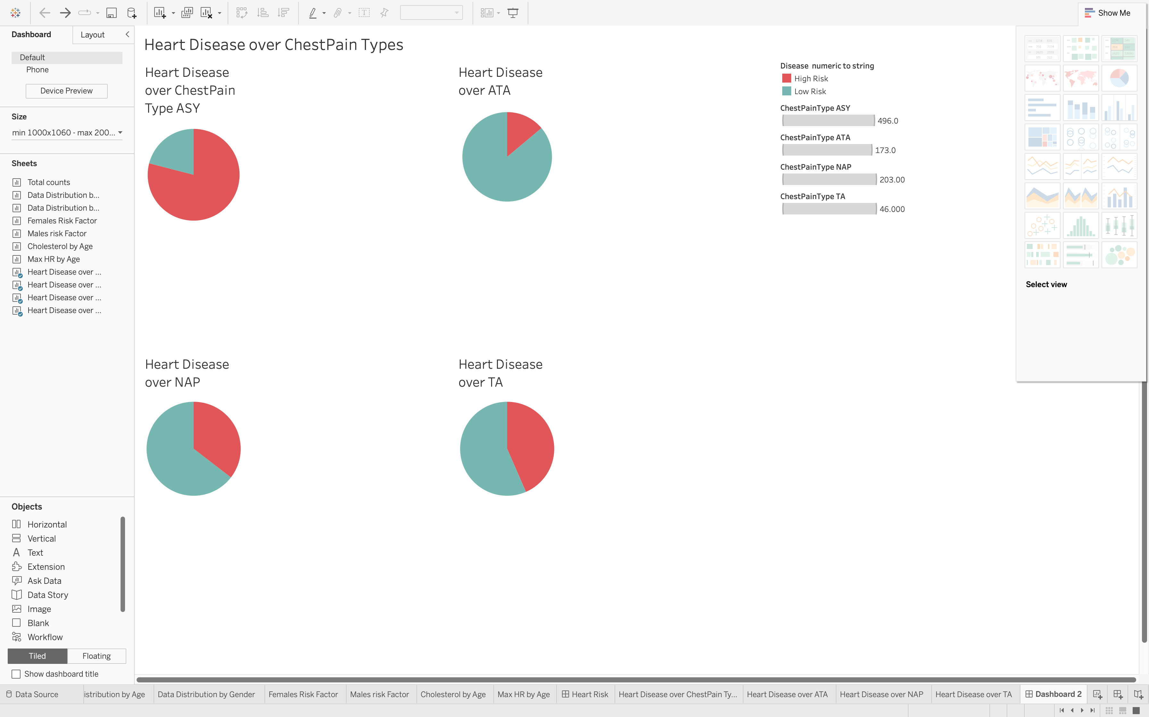
Data visualization
Heart risk over age and gender
Heart disease over types of chest pain
https://public.tableau.com/app/profile/manish.thapa4247/viz/Heartrisk/HeartRisk_1?publish=yes
https://public.tableau.com/app/profile/jingwen.zhou/viz/Heartrisk_16757344537410/Dashboard2

Slide 8
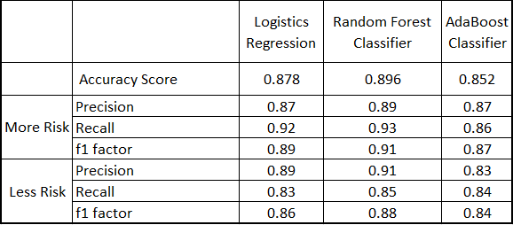
Summary
The high proficiency of the 3 models
The RandomForestClassifier model
The Recall score for More risk

Slide 9
Thank you for listening any question?

